Slide 1

GANs for Handwritten Digit Generation
A deep learning project using Generative Adversarial Networks (GANs) to generate realistic handwritten digits from the MNIST dataset.

Slide 2
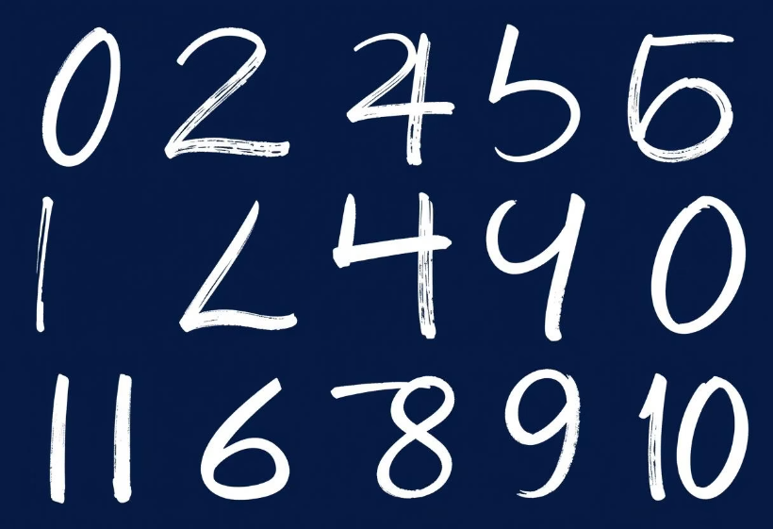
Problem Definition
Generating realistic handwritten digits is a challenging problem.
It has applications in data augmentation and synthetic data generation.
GANs offer a powerful approach to learning complex data distributions.
This project addresses the need for high-quality synthetic data for machine learning tasks.

Slide 3
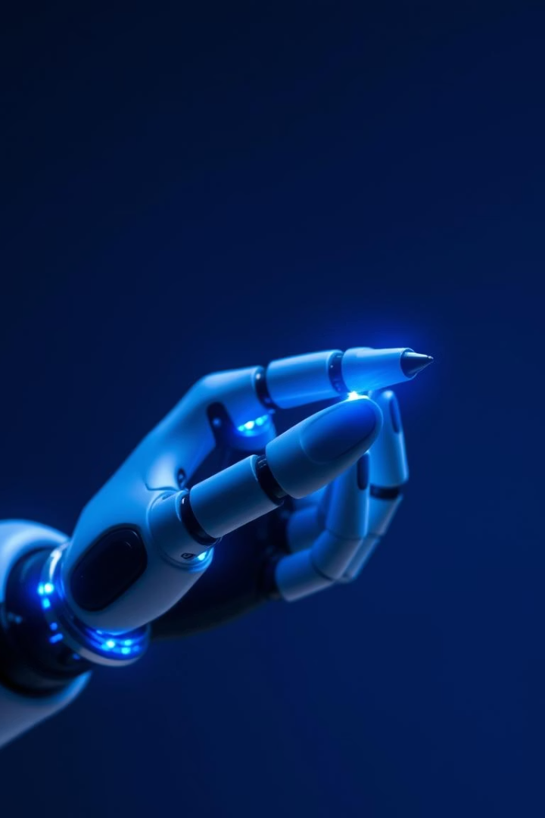
Objectives of the Project
1
Implement a GAN model
2
Train the GAN on MNIST
Build a GAN using PyTorch to generate handwritten digits.
Train the GAN model on the MNIST dataset.
3
Evaluate the generated images
Assess the quality and diversity of the generated digits.

Slide 4




Dataset Used: MNIST
70,000 images
28x28 pixels
Grayscale format
The MNIST dataset consists of 70,000 handwritten digits. Each image is 28x28 pixels in grayscale format. The dataset is split into 60,000 training images and 10,000 testing images.

Slide 5

Tools, Libraries & APIs
PyTorch
torchvision
A deep learning framework for building and training neural networks.
A PyTorch library that provides access to the MNIST dataset.
NumPy
A library used for numerical computations and array manipulation.

Slide 6
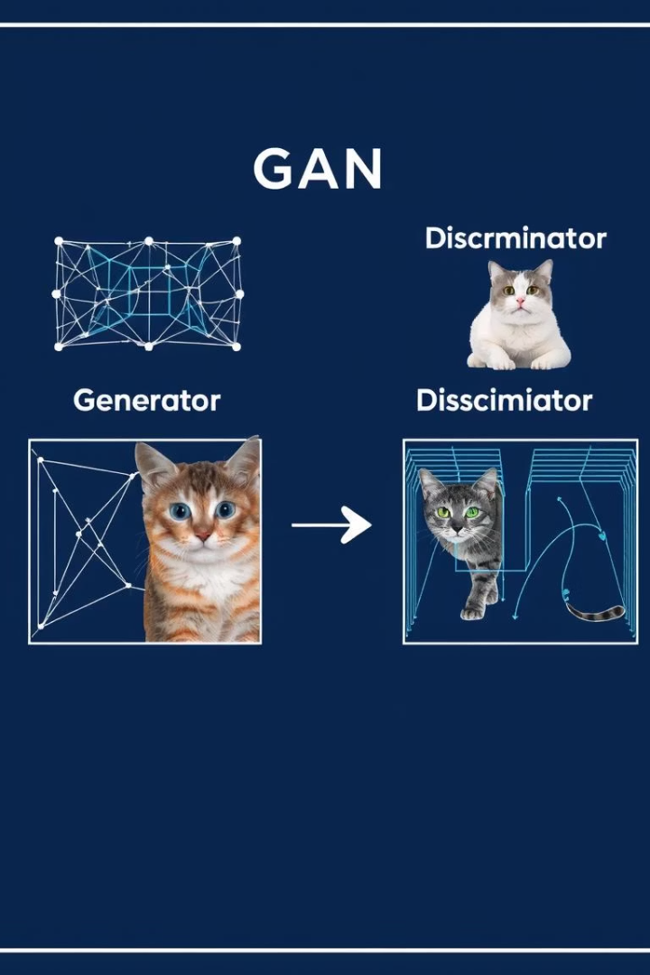



Introduction to GANs
Generator
Creates synthetic images from random noise.
Discriminator
Distinguishes between real and fake images.
Adversarial Training
The generator and discriminator are trained in an adversarial manner.

Slide 7





Model Architecture
Output
1
Digit image
Fully Connected Layers
2
Multiple layers
ReLU Activation
3
Generator layers
Leaky ReLU Activation
4
Discriminator layers
Input
5
Random noise
The Generator and Discriminator models are composed of fully connected layers and ReLU activations.
The discriminator uses leaky ReLU activations.

Slide 8
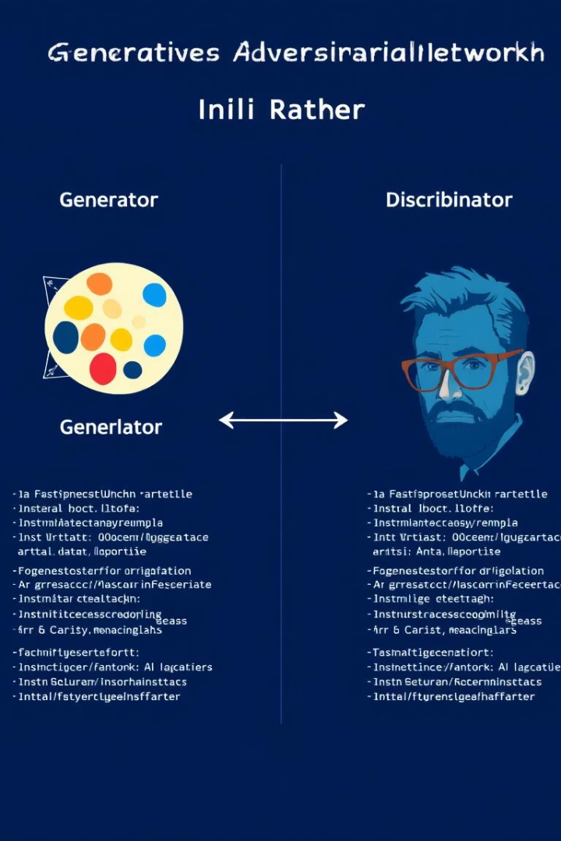
Implementation Details
Generator
Discriminator
# Generator model = nn.Sequential( nn.Linear(noise_dim, 128), nn.ReLU(), nn.Linear(128, 28*28), nn.Tanh() )
# Discriminator model = nn.Sequential( nn.Linear(28*28, 128), nn.LeakyReLU(0.2), nn.Linear(128, 1), nn.Sigmoid() )

Slide 9
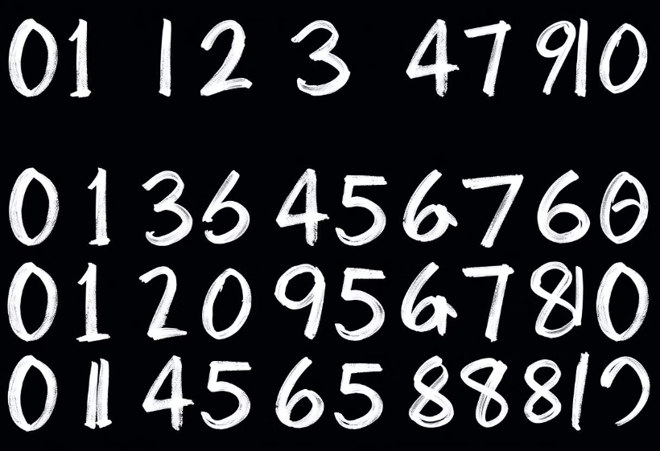
Result Analysis
The GAN successfully generates handwritten digits after training.
The quality of the generated images improves over time.
Loss graphs show the convergence of the generator and discriminator.
Further analysis can be done to evaluate the diversity and realism of the generated digits.

Slide 10
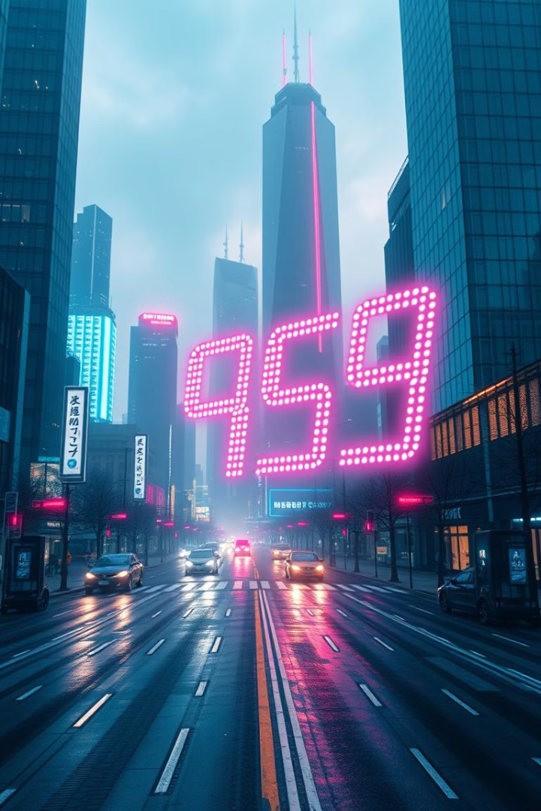
Conclusion & Future Work
Achieved digit generation
Successfully implemented and trained a GAN model to generate handwritten digits.
Conditional GANs
Explore Conditional GANs to generate specific digits.
DCGANs
Try Deep Convolutional GANs (DCGANs) for better image quality.

